Slide 1
Reducing File Size and The Single Responsibility Principle
David Sackstein
29/5/2025

Slide 2
Agenda
The Single Responsibility Principle
Horizontal and Vertical Violations
Benefits of the SRP
Addressing problems with the SRP
Proposed guidelines and techniques
TestCenterService as an example
Discussion

Slide 3
The Single Responsibility Principle
Classes, functions, components should do only one thing
This applies horizontally and vertically
Horizontally: A class (or function) should not do A and B and C
Vertically: A class (or function) should have one level of abstraction
So it should not do A, A.1, A.1.1 and A.1.2

Slide 4
Examples – Horizontal violation
Make Coffee
Check if cup is clean
If not wash it
Prepare coffee
Take some cheese cake
Drink the coffee
Enjoy the cake

Slide 5
Examples – Vertical violation
Make Coffee
Open coffee lid
Find teaspoon
Add teaspoon of coffee to cup
Add teaspoon of sugar to cup
Press red button on kettle
While button did not click back off, wait 5 seconds with 2 minute timeout
Open the fridge
Select preferred milk
Pour water and milk into cup

Slide 6
Examples - Good
Make Coffee
Add coffee to cup
Add sugar to cup
Boil water
Pour water into cup
Add milk

Slide 7
Benefits of the SRP
Easier to comprehend
Easier to maintain
Possible to test
Offers opportunities for reuse
Fewer conflicts between commits

Slide 8
Problems with the SRP?
Creates too many files and classes
Logic becomes difficult to follow and debug
It takes too long to implement – not a priority
Extracting code makes reviews more difficult
The "Not in this PR" consideration

Slide 9
Creates too many files and classes
Too many is only relative to your current perspective:
Ask yourself – have you ever encountered a group of classes and proposed that they should all be merged into one to make them easier to understand?
Creating classes with responsibilities is how we manage complexity. We create teams and delegate responsibilities.
You can place related classes in their own package
Often class extraction justifies a managing class just like teams need managers. (Just don’t call it Manager, please :)

Slide 10
Logic becomes difficult to follow and debug
On the contrary, layering allows the reader to focus on:
One level (vertical extraction)
One functionality (horizontal extraction)
at a time.
Would it be easier to understand why a REST operation returns 404 (Not Found) if you could follow the code into the DNS server? How about analysis of TCP packet fragmentation?

Slide 11
It takes too long to implement – not a priority
The key is not to fix the world. Rather:
Don’t make things worse. Add new code in a separate class rather than increase the size of an existing large one.
If possible make local improvements while you are at it.
Tomorrows big classes and technical debt are our responsibility today.

Slide 12
Extracting code makes reviews more difficult
When adding new code, this is not a problem.
On the contrary, adding a new class minimizes changes to existing code.
When changing existing code:
Separate refactoring commits and functional commits
Reviewers can safely ignore refactoring commits

Slide 13
The "Not in this PR" consideration
Maybe not in this PR but certainly in this ticket
Refactoring around a functional change is imperative
to prevent code rot
to reverse entropy increase
If both the refactoring change and the functional change are large, create two PRs
Your reviewer can approve refactoring PRs with little effort.

Slide 14
Proposed guidelines
Hard values are not popular, but I think they are useful
When you understand the benefits of the SRP you realize they are feasible
Hard values encourage developers to think about responsibilities
They help keep new classes small

Slide 15
Hard Numbers (putting my helmet on)
 | Optimal | Practical | Reasons to relax
Class length | 250 | 350 | Inline documentation
Method length | 30 | 40 | Comments, logs, formatting
Number of public methods | 5 | 10 | Controllers
Number of fields | 3 | 5 | Constants
Number of function arguments | 3 | 3 | An interface you don’t control
Number of levels of indentation | 1 | 3

Slide 16
Techniques
Extract class
Extract methods
Extract parameter objects
Repeat

Slide 17
TestCenterService as an example
Reasons it was chosen:
It is big (was almost 2000 lines)
It is well tested
I don’t understand what it does
Two first steps
Extract classes (Pull Request 95053)
Extract methods (Pull Request 95362)

Slide 18
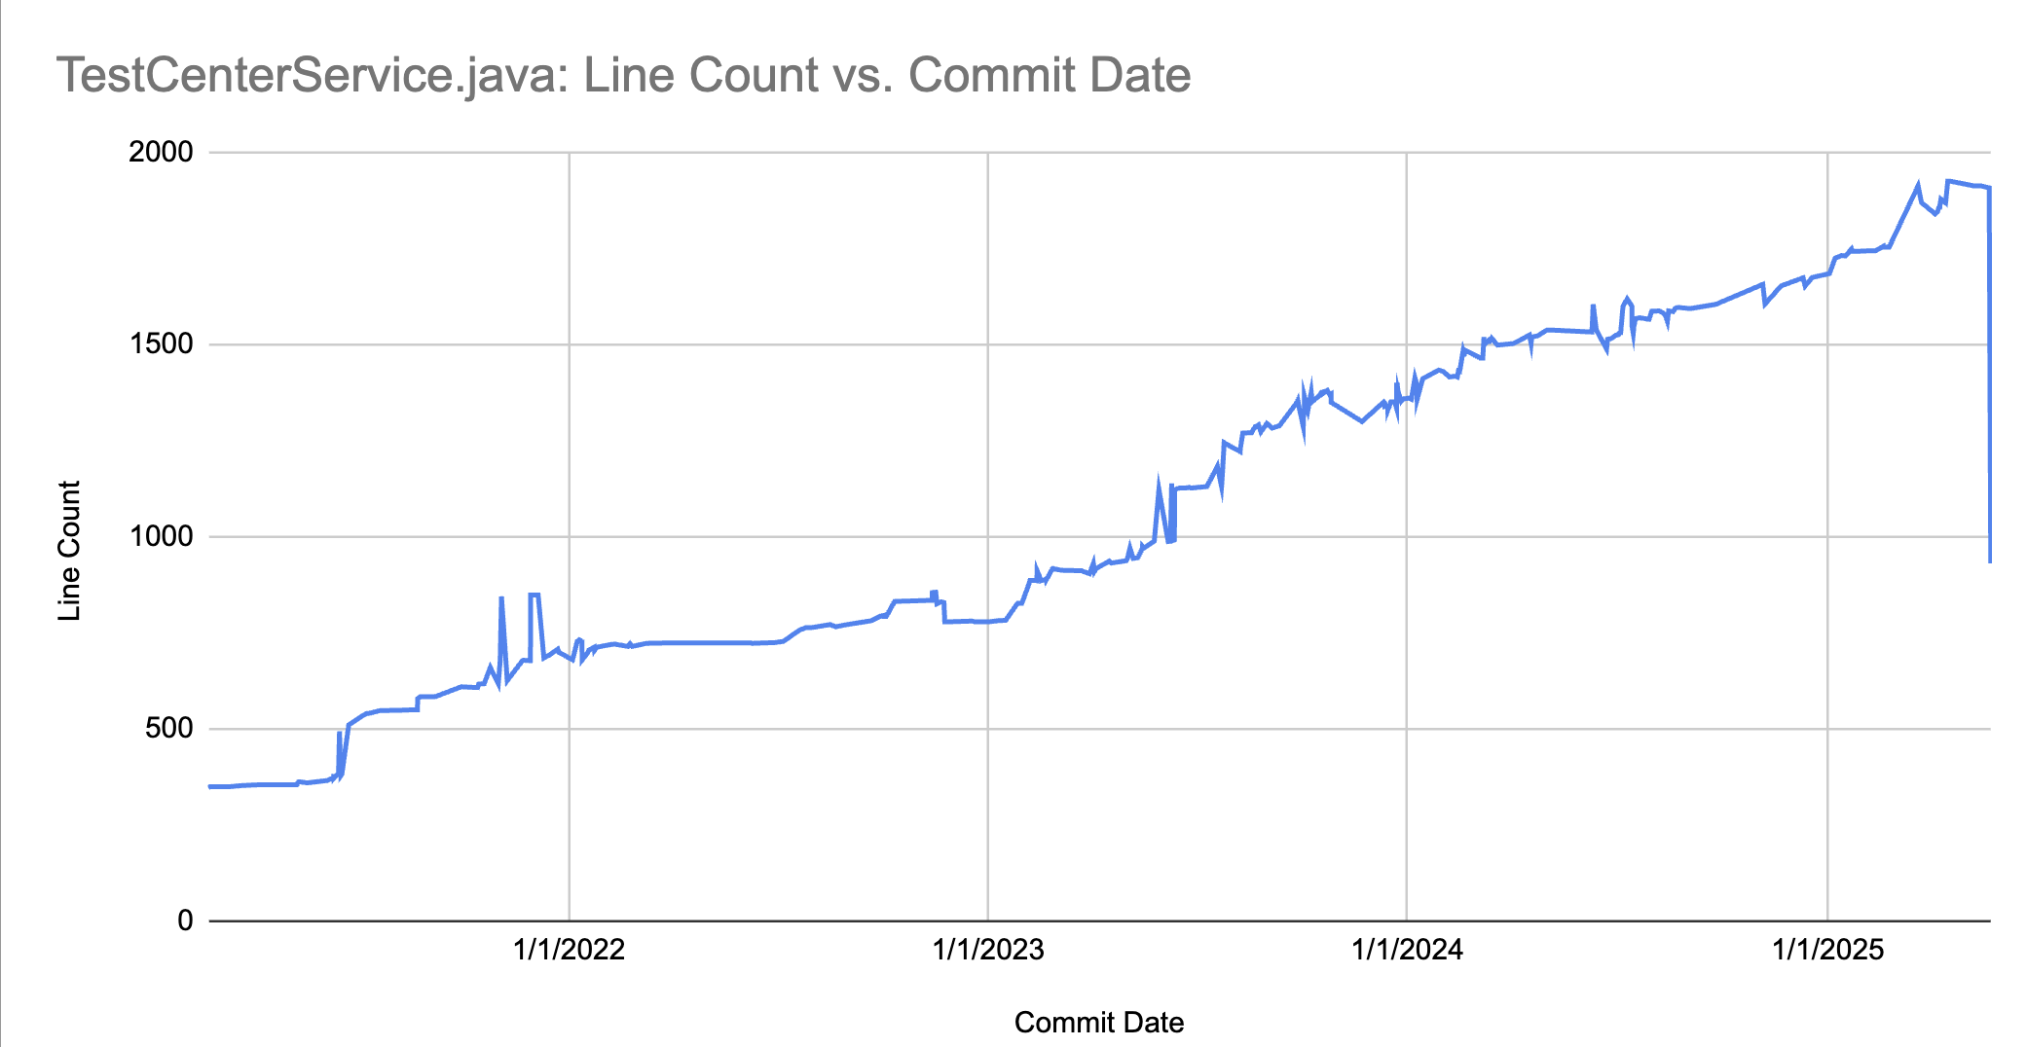

Slide 19
Let’s look at the results

Slide 20
Discussion

